Slide 1

OFFICE OF STUDENT LIFE
Staff Development
Maria J. Ortiz
Executive Director
Of Student Life
First Avenue School
August 29, 2019

Slide 2

TABLE OF CONTENTS
Welcome Back
Department Organization
Culturally Relevant Pedagogy
Department Mission
Newark Cares Presentation
Upcoming Events
Break Out Sessions
NPD/NBOE Collaborative - 2pm
A
G
E
N
D
A

Slide 3
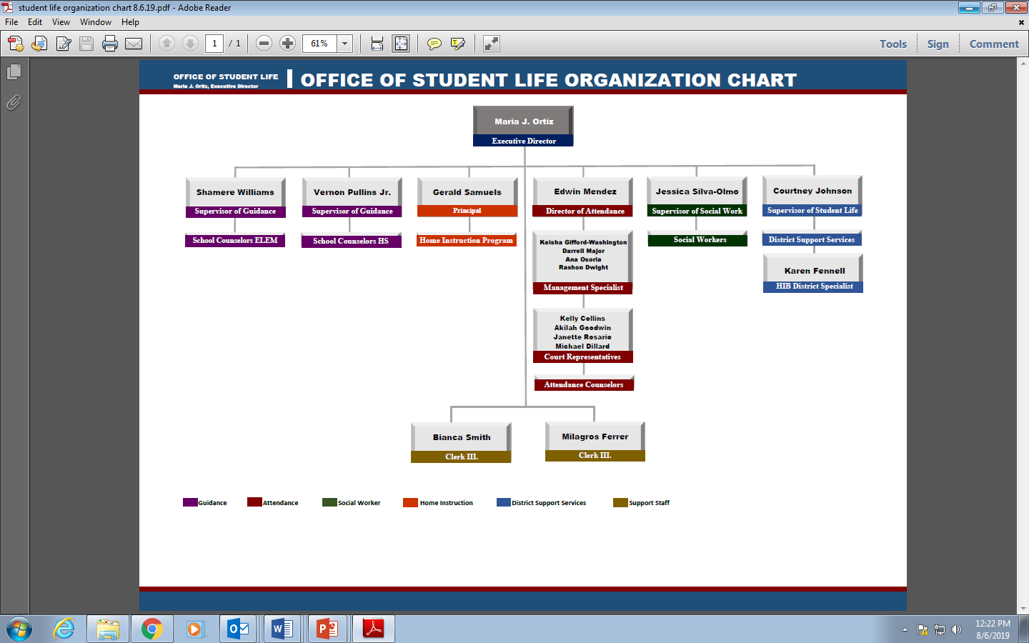
DEPARTMENT ORGANIZATION
OFFICE OF STUDENT LIFE

Slide 4
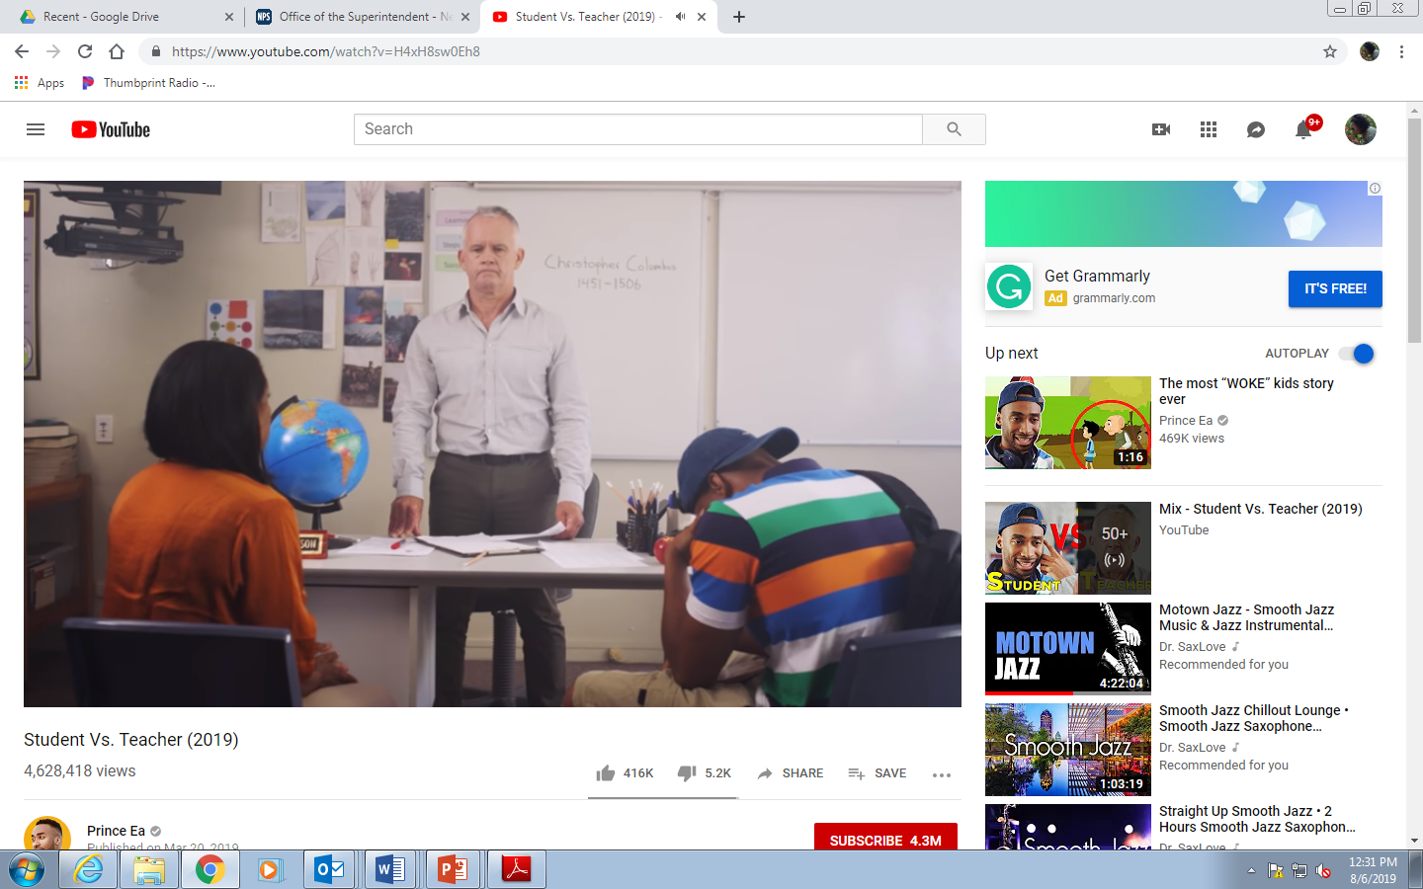
CULTURALLY RELEVANT PEDAGOGY
OFFICE OF STUDENT LIFE
Ladson-Billings
(1994, 2009)
“Culturally relevant pedagogy is a comprehensive framework, rooted in equity, that addresses teaching and learning opportunity gaps by building from students’ cultural backgrounds, interests and experiences as strengths in learning and creating new knowledge.”
“Culturally relevant education is a conceptual framework that recognizes the importance on including students’ cultural backgrounds, interests, and lived experiences in all aspects of teaching and learning within the classroom and across the school.”
Student Vs. Teacher

Slide 5
MISSION / CLARITY 2020
OFFICE OF STUDENT LIFE
To advance student success and close equity gaps by ensuring students attend school every day. Our mission is to support students’ learning through Innovation and Forward thinking Experiences to Love, Inspire, Focus and Excel.
Strength- Based and Responsive Culture
Integrated System of Supports
MISSION
PRIORITY 3:
PRIORITY 5:

Slide 6


ATTENDANCE WORKS RESOURCES
OFFICE OF STUDENT LIFE

Slide 7

Newark CARES

Slide 8

What is Newark Cares?
Modeled after the “Handle with Care” program started in West Virginia in 2013.
Collaboration with Newark Board of Education, Newark Public Schools, Newark Police Department and the Drug Enforcement Administration (DEA) / High Intensity Drug Trafficking Areas (HIDTA)
The Newark Cares program provides a framework for law enforcement and school personnel to assist with mitigating the negative affects experienced by children exposed to a traumatic or critical event, commonly referred to as Adverse Childhood Experiences (ACES).

Slide 9
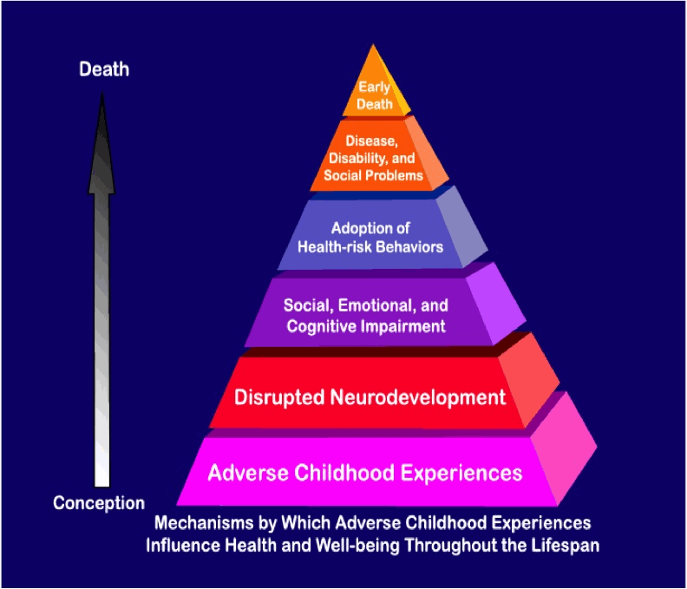
Adverse Childhood Experiences (ACE) Study
The Adverse Childhood Experiences (ACE) Study is one of the largest investigations ever conducted to assess associations between childhood maltreatment and later-life health and well-being.
Michael McKnight
Resiliency Team Training Summer 2019
Notes:
The Adverse Childhood Experiences Study ( ACE’s) is one of the largest investigations ever conducted to assess associations between childhood maltreatment and later-life health and well being out comes.
The initial phase of the ACE Study was conducted at Kaiser Permanente from 1995 to 1997, and more than 17,000 participants had a standardized physical examination. No further participants will be enrolled, but we are tracking the medical status of the baseline participants.
Each study participant completed a confidential survey that contained questions about childhood maltreatment and family dysfunction, as well as items detailing their current health status and behaviors. This information was combined with the results of their physical examination to form the baseline data for the study.

Slide 10

ACE Indicators
Abuse
Neglect
Family/ Household Challenges
Death of a parent
Divorce
Witnessing domestic violence
Living with someone who has mental illness or addiction
Incarceration of a family member
Economic hardship
Social exclusion by peers
Michael McKnight
Resiliency Team Training Summer 2019
Notes:
Findings:
Childhood abuse, neglect and exposure to other traumatic stressors are common!
In the US, 50% of children have experienced at least one or more adverse experience
33% of youth between the ages of 12-17 in the US have experienced 2 or more ACE’s
One out of eight children (12%) have had three or more negative life experiences
associated with levels of stress that can harm health and brain development
Since the original study many urban areas have conducted more research…
Urban ACE’s Study: Philadelphia
A total of 1,784 adults completed the Philadelphia Urban ACE Survey for a response rate of 67.1%. The survey found a higher prevalence of ACEs than found in previous studies.
In particular, 33.2% of Philadelphia adults experienced emotional abuse and 35% experienced physical abuse during their childhood.
Approximately 35% of adults grew up in a household with a substance-abusing member; 24.1% lived in a household with someone who was mentally ill; and 12.9% lived in a household with someone who served time or was sentenced to serve time in prison.
The Philadelphia Urban ACE Survey also examined the stressors that exist in the communities where people live.
The study found that 40.5% of Philadelphia adults witnessed violence while growing up, which includes seeing or hearing someone being beaten, stabbed or shot.
Over one-third (34.5%) of adults reported experiencing discrimination based on their race or ethnicity, while almost three in ten adults (27.3%) reported having felt unsafe in their neighborhoods or not trusting their neighbors during childhood.
In all, over 37% of Philadelphia respondents reported four or more ACEs.
The findings from this study suggest the need for services that address the unique environmental stressors experienced in urban neighborhoods to mitigate their impact on individuals and prevent ACEs.

Slide 11
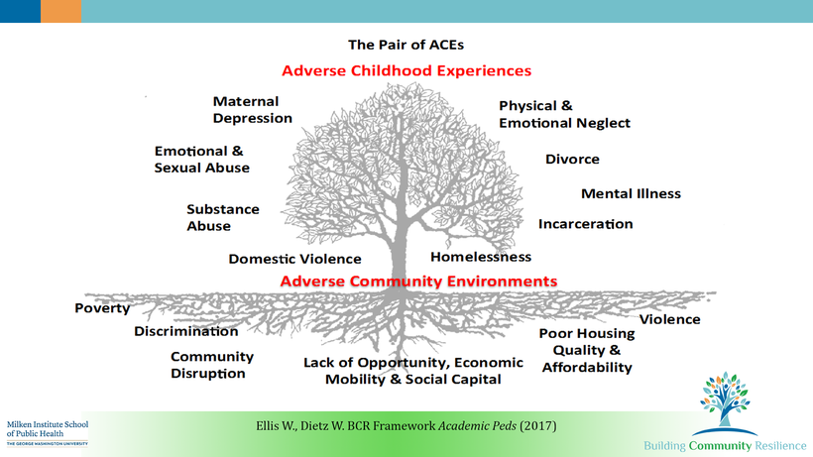
The Pair of ACEs
Michael McKnight
Resiliency Team Training Summer 2019
Notes:
Adverse Community Environments also add to the toxic level of stress experienced.

Slide 12
Newark Cares
When Newark Police respond to a incident and there are children present, they are required to fill out a Newark Cares form.
This form only has the name, age and grade of the child and where they go to school. No information about the type of incident is documented on the form.
The form is forwarded to a centralized email, where Newark Cares personnel send it to the school the next morning.
The Newark Cares program provides awareness to the school when a child was exposed to a potentially traumatic event.

Slide 13
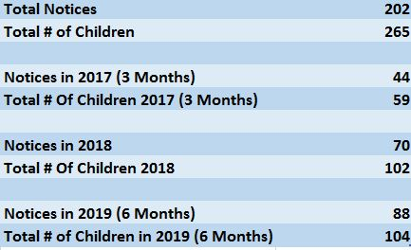
Next Steps
Currently the Newark Cares program is in Phase 2 of implementation.
We aim to track the metrics of Newark Cares and provide training to schools and police on ACE’s, trauma informed care and resiliency.
We’ve partnered with Rutgers Health - University Behavioral Health Care, Newark Arts Council and 4 Directions Seminars to help with the trainings.

Slide 14

Contact Information / Questions / Comments
HIDTA/ DEA: ASAC Christopher A. Jakim- christopher.a.jakim@usdoj.gov
HIDTA/ DEA: Joanna Mlicka-Anderko- janderko@nynjhidta.org
Newark Police Department: Lt. Emil Cardona- cardonae@ci.newark.nj.us
NPS Office of School Safety: HBullock@NPS.K12.NJ.US

Slide 15

NBOE SEL & MENTAL HEALTH SURVEY
OFFICE OF STUDENT LIFE
Principal were asked to complete cthe following by
August 23, 2019 – soft due date
August 29, 2019 – hard due date
  Social Emotion Learning & Mental Health Survey

Slide 16
UPCOMING EVENTS & TESTING DATES
OFFICE OF STUDENT LIFE
ACTIVITY | DATE
Aetna Healthcare Screening Back to Back Bash (11AM-3PM) | Aug. 24, 2019
Professional Development SST Members (First Avenue School) District Back Pack giveaway (School Stadium/3PM-6PM) | Aug. 29, 2019
Suicide Prevention Month | Sept. 1 – Sept. 30, 2019
2020 Mentors by 2020 Launch | Sept. 1, 2019
Week of Respect | Oct. 7 – Oct. 11, 2019
DEA Summit (Grades 6-8) | Oct. 9, 2019
Violence Awareness Week | Oct. 21 – Oct. 25, 2019
Red Ribbon Campaign | Oct. 23 – Oct. 31, 2019
American Education Week | Nov. 11—Nov. 15, 2019
Essex/Newark HBCU College Fair | Nov. 21, 2019
NJ School Counselor Week | Feb. 3 – Feb. 7, 2020
School Social Work Week | March 1 – March 7, 2020
National Prevention Week | May 11 – May 15, 2020
Pride Month | June 1 – June 22, 2020

Slide 17
UPCOMING EVENTS & TESTING DATES
OFFICE OF STUDENT LIFE
SAT TEST DATES | ACT TEST DATES
August 24, 2019 | September 14, 2019
October 5, 2019 | October 26, 2019
November 2, 2019 | December 14, 2019
December 7, 2019 | February 8, 2020
March 14, 2020 | April 4, 2020
May 2, 2020 | June 13, 2020
June 6, 2020 | July 18, 2020

Slide 18
Break Out Session
Break Out Sessions
Elementary: School Counselors
  Location: Room 148- Music Room
High School: School Counselors
  Location: 148a- Music Room
Social Workers (ALL)
  Location: Auditorium
Attendance Counselors and Truancy
  Location: Cafeteria
LUNCH: 12:15pm-1:00pm

