Slide 1
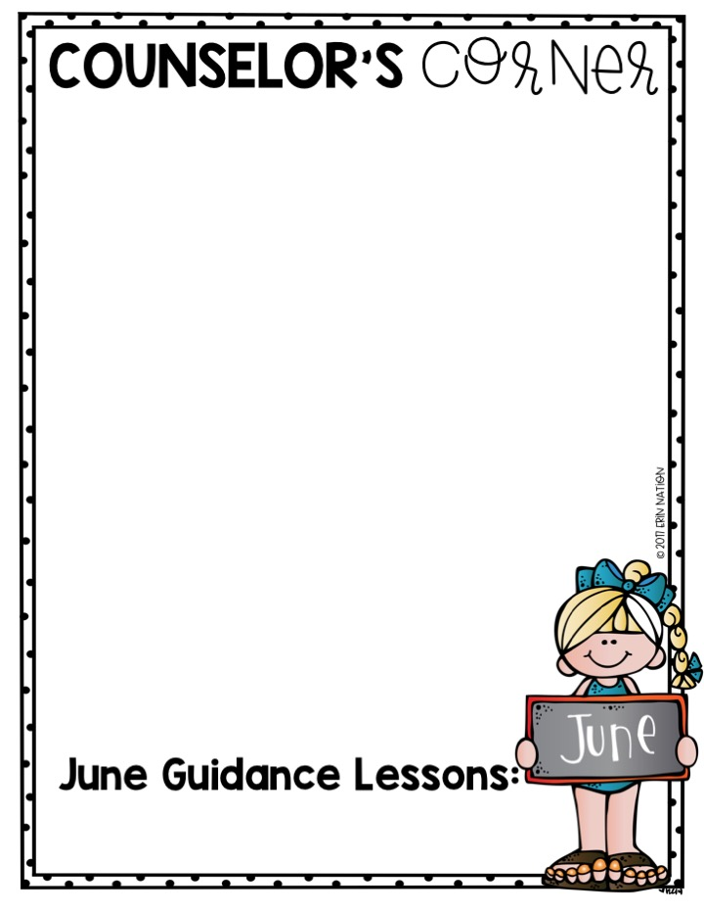
Lafayette Street School
Mrs. Greenstein, School Counselor, email: dpereira@nps.k12.nj.us
Attention Students: Great job completing the 19-20 school year!
This year began as a typical school year would with excitement, laughter, first day jitters, crying, some confusion and uncertainty. However, they were familiar emotions to us and safe to say expected. As we end the school year, our sense of “normalcy” has changed. Nevertheless, we remained FALCONS! We were able to reach the stars and saw the sunshine ahead.
You are my HEROES! I am so proud of your accomplishments and how well you adapted to virtual learning. You are strong and dedicated! I am honored to be a part of your life. I have watched you evolve into responsible, respectful, KIND, smart and fearless young adults.
I want to wish you all an enjoyable, safe and healthy summer vacation. I will miss you! Love you, Mrs. Greenstein
Attention Parents: Preparing for TRANSITION
Our students experience many different transitions! Perhaps they will be making the jump from kindergarten to first grade this coming fall, or maybe they will be making the big move from middle school to high school! No matter the transition, as parents you will want to make the transition as smooth as possible so that each child has a successful year. As this school year nears an end, think about these ideas to help your child through the summer to their new year:
•Talk about the positives of entering a new grade, new teachers, new friends, and new opportunities.
•Address your child’s fears. Listen to and validate these fears and don’t ignore. Talk about your fears when you were that age.
•Begin preparations early. Start setting earlier bedtime routines in summer to help prepare for the transition back to school.
Important Reminders, Events, Key Dates
*June is National Hunger Awareness Month!
* International Children’s Day- June 1st
* Last Day of School- June 18th
* Congratulations to the Class of 2020! We wish you success!
Academic Readiness and Transitions
Termination of School Counseling Services
Summer Safety

