Slide 1
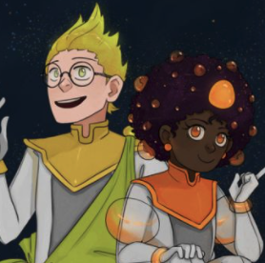
LEGENDARY SPRING BREAK CHALLENGE
Engaging Educational Experiences at Home during Spring Break! Join the Legends team for some fun and games this Spring Break (4/7– 4/16) and continue to build your science knowledge! Take the Spring Challenge and complete your grade level video games to be entered into a drawing for some amazing prizes!
The Challenge:
Any 6th – 8th grade student who completes THEIR GRADE LEVEL assignment during the Spring Recess (4/7 – 4/16) will be entered into a drawing for Legendary prizes including: A Superhero Cape & Legends Swag!
How to get started:
Log into Legends of Learning at home
Select the Button for “Teacher Assignments”
Enter the Teacher secret Code : NPSSTUDENT (Click the NPSSTUDENT code Button after the 1st login)
Click on your grade level assignment and start Playing!
Continue the Adventure in

